Slide 1
Industry Type: Auto Rice Mill
Visited Industry Name: Kohinoor Auto Rice Limited
Location: House: Purbo Sharikkhali, Bashak Bazar, Upazila: Patuakhali Sadar, District: Patuakhali, Division: Barisal.
Number of Total Workers: 45

Slide 2



Name: Md. Afridi Alom Pranto
ID No: 2102027
Reg No: 10154
Session: 2021-22
Level-II, Semester-II
Name: Mehedi Hasan
ID No: 2102007
Reg No: 10134
Session: 2021-22
Level-II, Semester-II
Name: Nazmus Sakib
ID No: 2102066
Reg No: 10193
Session: 2021-22
Level-II, Semester-II

Slide 3
Welcome

Slide 4
3. Problem Identification
Through interviews with staff and observation of current workflows, we identified the following key problems:
Manual Record Keeping: Inventory records are maintained on paper or in basic spreadsheets, leading to errors, duplication, and data loss.
Lack of Real-time Inventory Updates: There is no system to update inventory in real-time as rice is processed, packaged, or shipped.
Poor Traceability: Tracking of raw materials, processing batches, and final products is difficult due to disjointed records.
Inefficient Reporting: Generating reports for stock, production, and sales takes considerable time and often lacks accuracy.
No Centralized System: Data is siloed across departments without centralized access or integration.

Slide 5
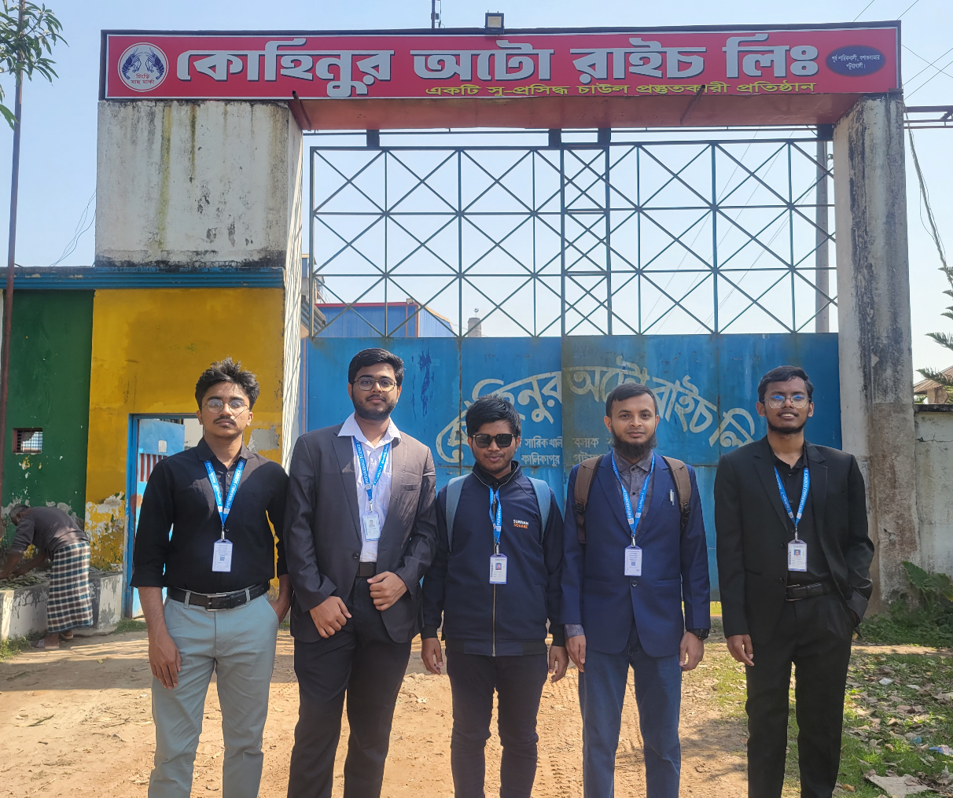
Fig: In front of the Rice Mill

Slide 6
Target Users
Inventory Managers
Production Supervisors
Sales and Dispatch Officers
Administrative Staff
Development Platform
Programming Language: C#
Framework: .NET
Database: MySQL

Slide 7
System Features
1. User Authentication
Secure login for different user roles (admin, manager, staff).
2. Inventory Management
Real-time stock updates for raw rice, processed rice, and by-products.
Add/Edit/Delete inventory items.
Automatic stock adjustments based on operations (e.g., milling, dispatch).
3. Production Tracking
Log daily production inputs and outputs.
Track material usage and batch details.

Slide 8
4. Sales and Dispatch Module
Record sales orders and deliveries.
Update inventory on dispatch.
5. Reporting
Generate reports for stock levels, production summaries, and sales.
Export to Excel or PDF.

Slide 9
Outcome and Benefits
The system will bring the following benefits to Kohinoor Auto Rice Limited:
Reduced Manual Errors
Faster Decision Making
Improved Operational Visibility
Better Resource Planning
Enhanced Traceability and Accountability

Slide 10
Any Question?

Slide 11
Thank
You

